Slide 1

GTJ GADGETS CO.
Piero Fano
Guillermo Ahumada

Slide 2
Executive Overview
Name of Organization: GTJ Gadgets Co.
Name of product: Peace Maker
Mission Statement: To deliver the best present anyone could ask for; the future.
Goals:
Make our product affordable for consumers (120.00)$
Create and introduce a new line of upscale products for a different part of the market.
Put other competitors out of business with our upcoming customizable design feature.

Slide 3

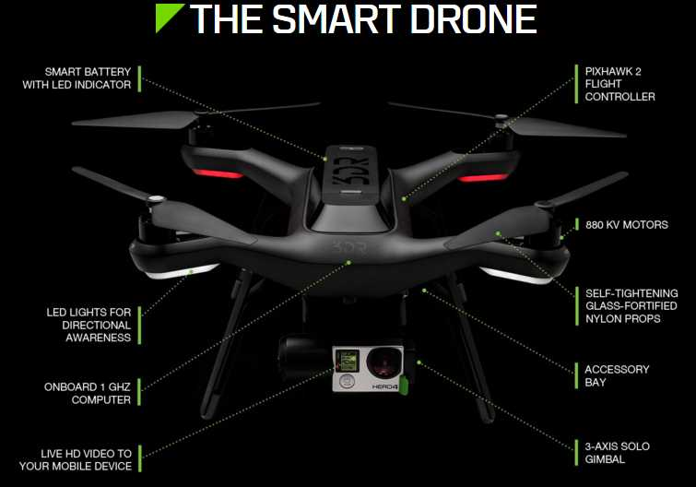
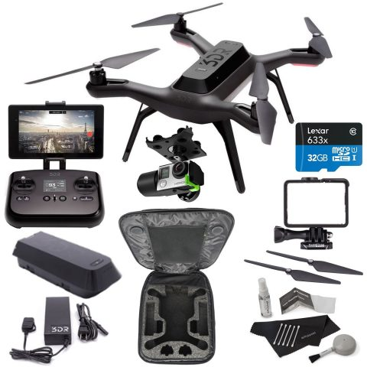
PRODUCT MIX
MAIN PRODUCT LINE :

Slide 4
SWOT ANALYSIS
INTERNAL
Strengths:
Multilingual R&D department.
Highly creative design team.
young and ambitious staff.
Weaknesses:
Limited experience.
Lack of economical resources compared to our competitors.
Team chemistry still has room for improvement.

Slide 5
SWOT ANALYSIS II
EXTERNAL
Opportunities:
This is a relatively new market.
It is a growing and a very promising industry.
Exponential growth of interest in technology.
Industry versatility.
Threats:
Brand loyalty to competitors amongst consumers.
Rapidly evolving market.
Consumers may infringe privacy of others on our product expense.
Regulatory changes and restrictions.

Slide 6
COMPETITION ANALYSIS
DJI:
Very good quality products.
Premium pricing strategy
Intensive distribution
Consolidated in the market.
Parrot:
Fairly good quality
Competition based pricing
Selective distribution
Fairly strong market presence.
GTJ Gadgets:
Superior quality.
Bundle and market penetration pricing strategies.
Selective distribution.
New in the market.
vs

Slide 7
MARKET SEGMENTATION STRATEGY
Demographics:
Caucasian and Asian Consumers.
Consumers within the age range of 18-35 years old.
Consumers from the upper middle class.
Behaviors:
Medium-heavy product usage.
Loyal customers.
Psychographics:
Thriving businesses and young adults.
Filmmakers and drone enthusiasts.

Slide 8
MARKET POSITIONING AND DIFFERENTIATION
Longer lasting rechargeable battery.
Aesthetical.
High quality for a fairly low price.
Very affordable.
We thrive for joyful memories and experiences.

Slide 9
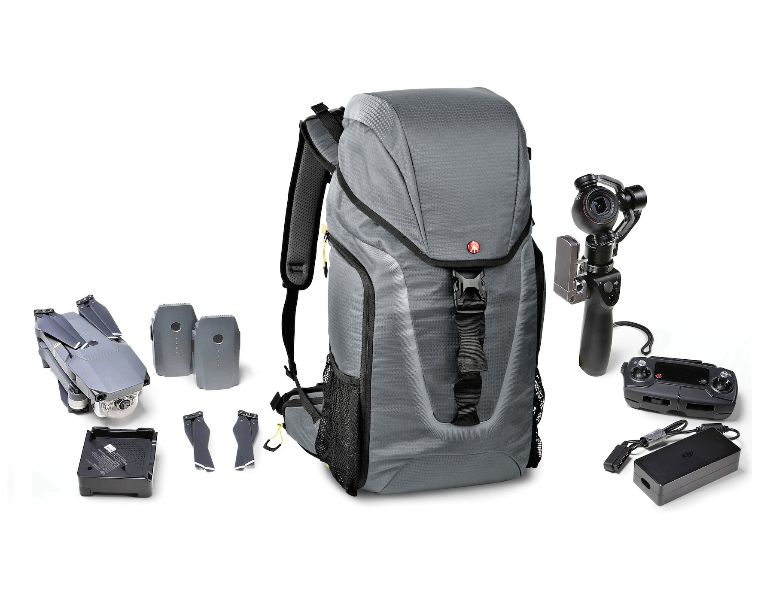
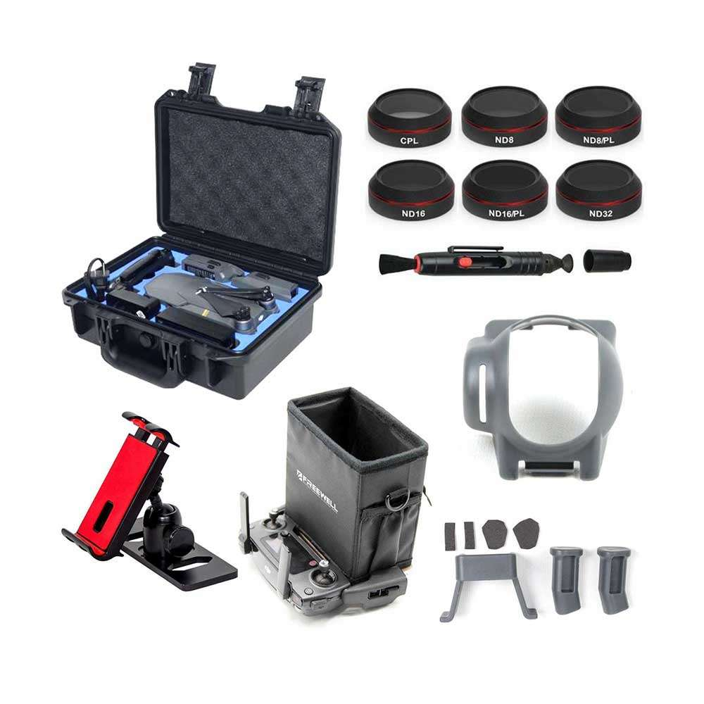
MAJOR PRICING STRATEGIES
Market bundle and market penetration pricing strategy
When buying the drone you will receive a customize peace drone bag of complementary accessories.

Slide 10
PRICING EXPECTATIONS
Our suggested retail price is $120.00
Costs(1000 units):
Total variable costs: $91,000.00
Total fixed cost per period (3 months): $22,475.00
Total costs $113,475.00
Break Even point:
775 units sold
Our Company will make a $6,525.00 net profit per period (3 months).
Sales volume per period is 1000 units
24.1% Markup ratio. (Retail price--Total variable cost)

Slide 11
Marketing Strategy
Place:
Headquartered in San Diego, CA
Selective Distribution:
Peace Drones will only be sold only at a select few stores giving us optimal market coverage, with less cost and more control over the product
Direct Channel: Company website; GTJGadgetsco.com
Indirect Channel: Sears, Best Buy, and Brookstone
Type of intermediaries: Agents & Retailers

Slide 12
Promotion Strategy
Promotion: B2B combination
Personal Selling: Approach Businesses directly, Best Buy, Brookstone, etc
Advertising: Tech Magazines, Social Media, Radio, and Event Sponsoring,
Digital Marketing: Facebook, Twitter, Instagram, YouTube, Snapchat, Pinterest, LinkedIn, and the Company Website
Sales Promotion: Lower prices, bundling, loyalty program
Public Relations: Social media manager, publicist, spokesperson
Notes:
Publicist: help develop and execute our brand strategy while promoting our professional work and brand

Slide 13
FINANCIAL PROJECTIONS
Short term (1 year):
$6,525.00 profit per period. (3 months=1 period).
We expect to make at least $55,000.00 profit from sales in the 1st year.
Our prices will increase each year by 5%.
Long term (5 years):
We expect to be amongst the top companies on the market.
International brand recognition.
Markup ratio above 30%.

Slide 14
IMPLEMENTATION PLAN
Our marketing department will work alongside web technicians and website designers,in order to create our own website, where our customers can directly obtain our products and services. This website will be updated periodically.
Our marketing department will open customer service through phone lines, so customers can communicate directly with us.
Will initiate a social media management section within our company, in order to handle, monitor,and manage all affairs related to social media and its derivatives.

Slide 15
EVALUATION & CONTROL METRICS
Customer reviews and feedbacks through our website.
Constant examination of social media.
Monthly analysis of sales.
Monthly competition analysis.
Quarterly swot analysis.

Slide 16
Thank you for your time!

